Slide 1

Recommendation Engine Improvements
Team GUGU
Xianqian(Sarah) Yang
Kejia Ran
Minchuan(Miko) Liu
Biao Zhang
Yuanyang(Jerry) Chang
Yue Sun
Notes:
*Need update
Title might change

Slide 2






Our Core Team
Data Team
Marketing Team
Financial &
Customer Relation Team
Sr. Data Scientist
VP Marketing
Ecommerce Financial
Manager
Website Analyst
Marketing Manager
Customer Satisfaction Manager
Notes:
*Division assigned(Data, Business)
Smaller logo

Slide 3
AGENDA
01.
Executive Summary
02.
Data Analytics
03.
Marketing Plan
04.
Next Step

Slide 4
PART 01
Executive Summary

Slide 5
Executive Summary
We would like to improve the existing engine by customizing book recommendations based on consumption behaviors.
This is achieved by hierarchical clustering, RFM analysis and customer insight analysis.
As a result, we can boost
About 26% sales from the top 15% customers
About 12% sales from the remaining 85% customers
Notes:
*need to change specified name
Shorter

Slide 6
Project Timeline
Implementation Stage
- A/B Testing
- Collect more data
- Further improve
marketing plan
3rd Phase
Review
Initial Stage
Analyze current dataset to understand customer behaviors and create new segments
1st Phase
2nd Phase
Intermediate Stage
Background
Design marketing strategies to improve website performance and increase sales revenue
Recommend “most popular ” books to all customers
Notes:
Period need to update (shorter)
IMplementation
Stage
Highlight current stage

Slide 7
PART 02
Data Analytics
Notes:
*Title might need to change (data analytics & result ?)

Slide 8
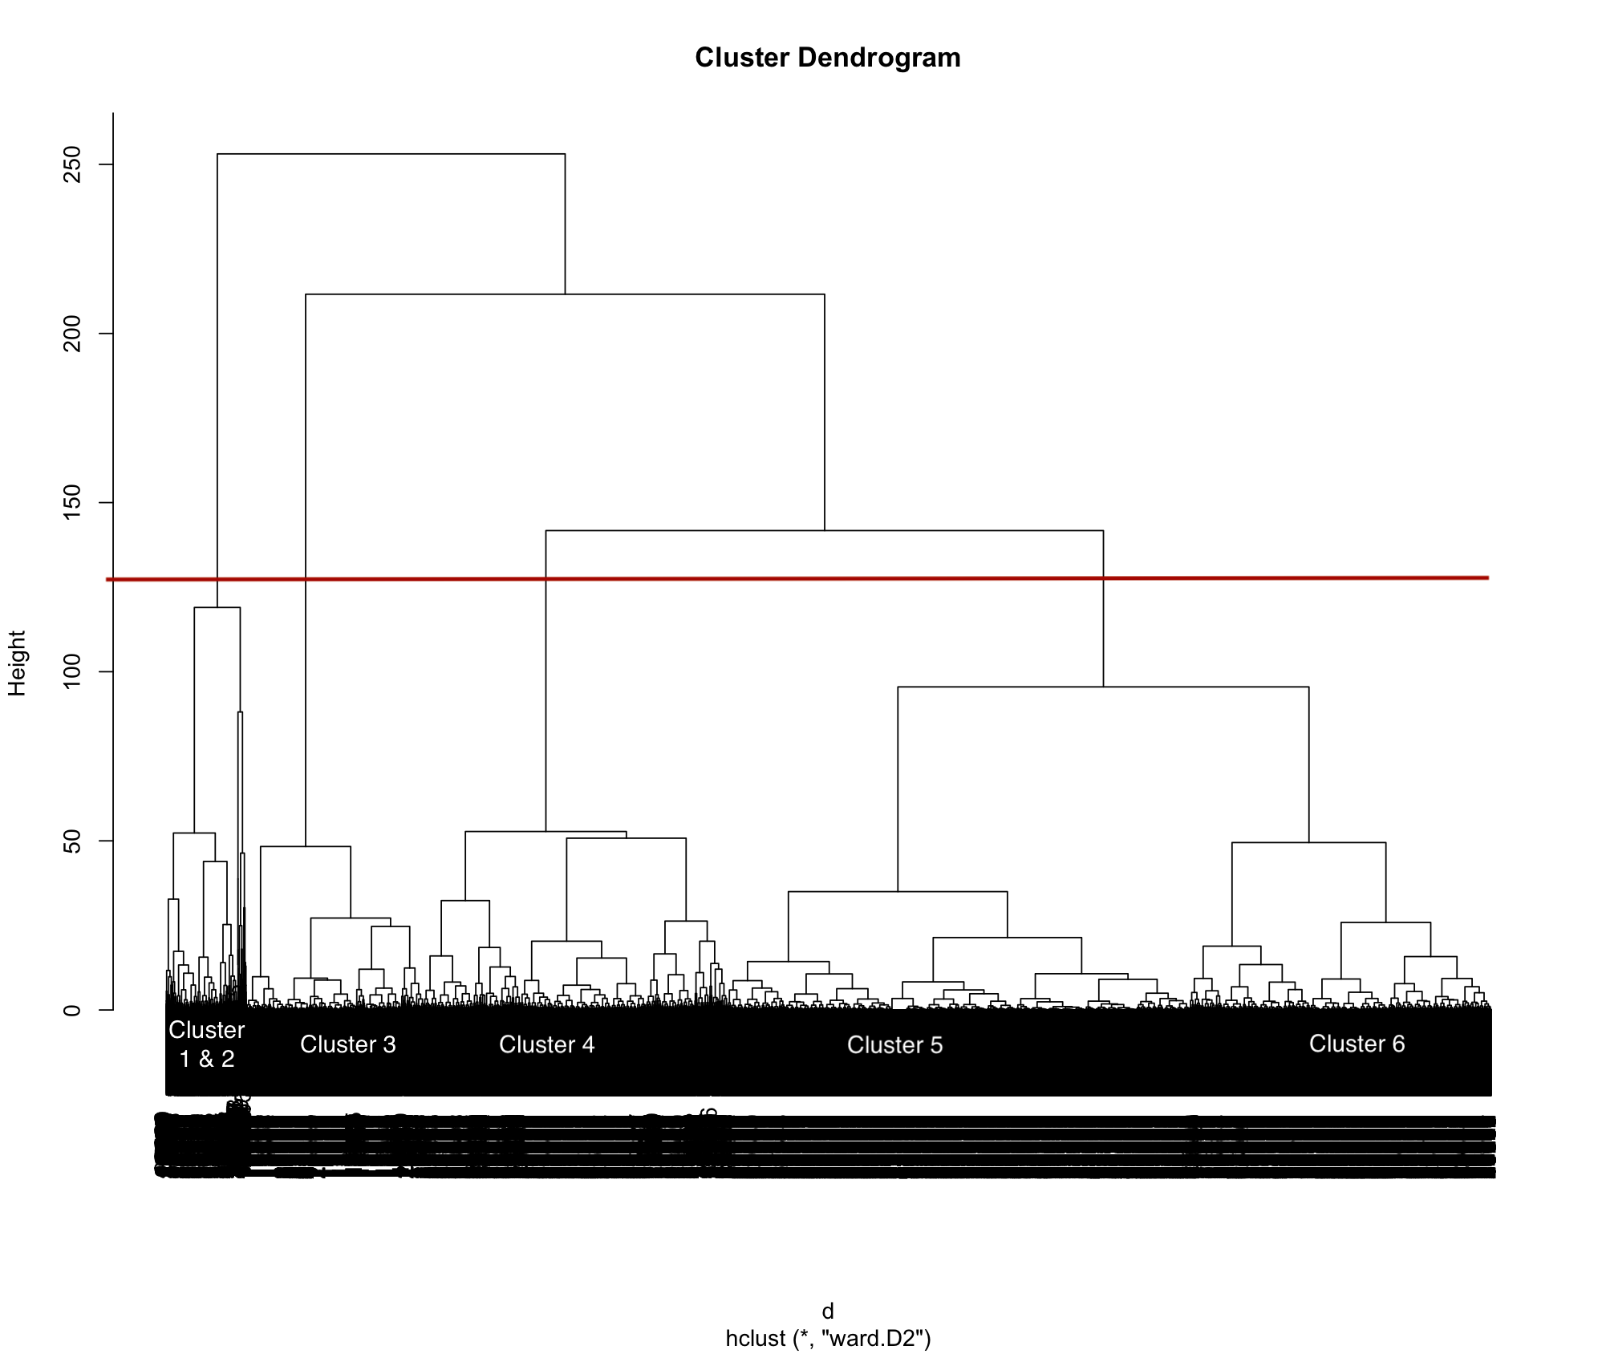
Algorithm and Design Methodology
Design Methodology:
Cluster → Assign RFM Score →
Match Traits → Customize Book Recommendations
Hierarchical Clustering:
Ward’s Method:
Variance based, no need to specify numbers of clusters
RFM Analysis:
Ranges cut off by the mean value of corresponding clusters
Assign score (1-6) to each group (e.g. r = 6 for the most recent customer group)
Match clients to proper groups based on their consumption behaviors
Notes:
Process of data processing - Kejia

Slide 9
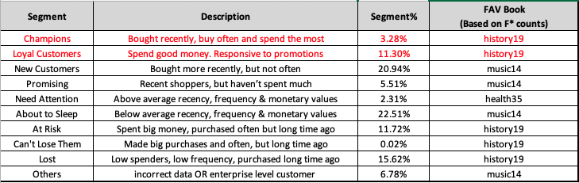
Customer Segmentation
Champions/Loyal Customers received the highest scores in each category (e.g. rfm = 666)
Customers from the middle segments (~40%) have exhibited different book preferences than the most popular item
Others: we need further investigation into their consumption pattern
Notes:
A,B,D,I column (All 11 groups)

Slide 10
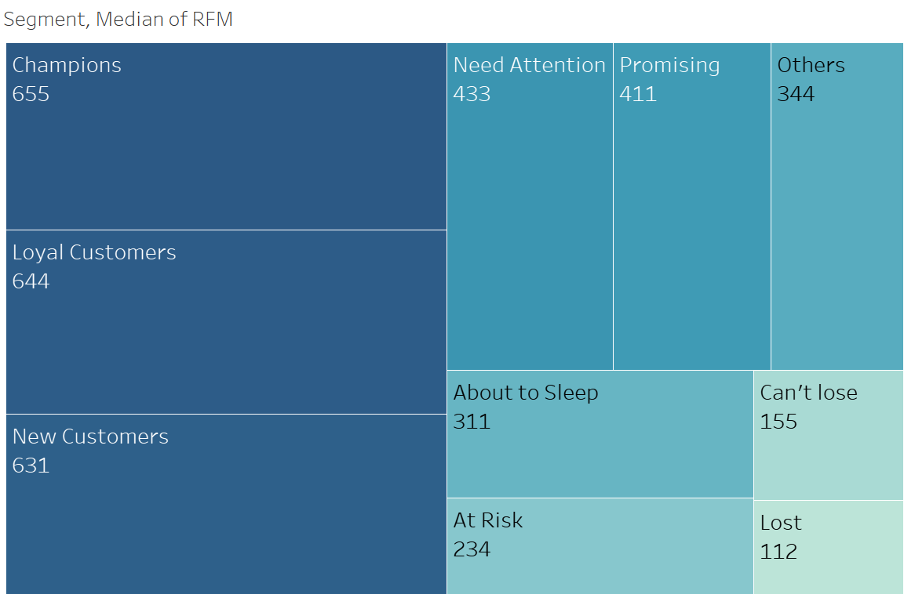
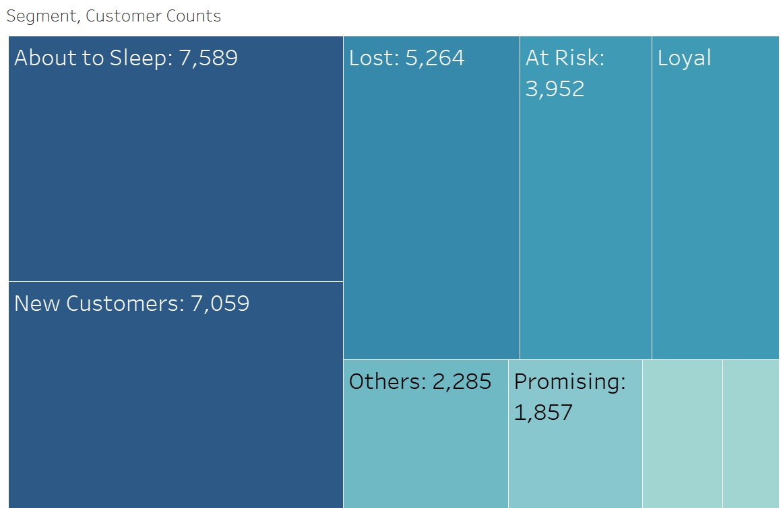
Data Visualization
Notes:
Yue will add dashboard and worksheet to here - Yue

Slide 11
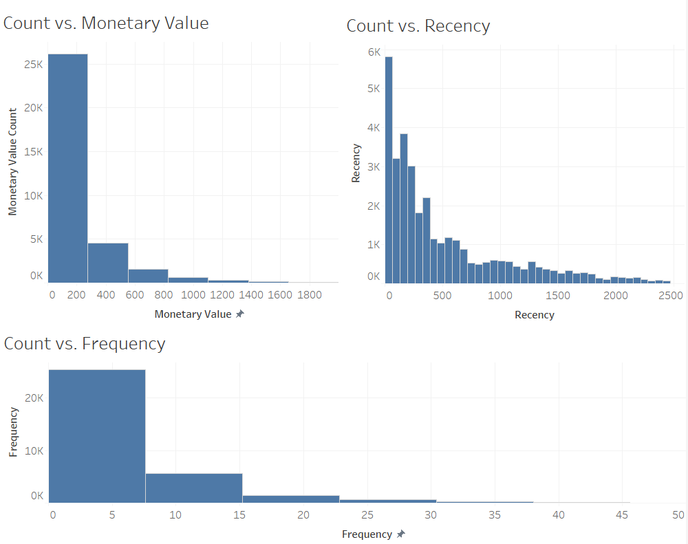

Slide 12
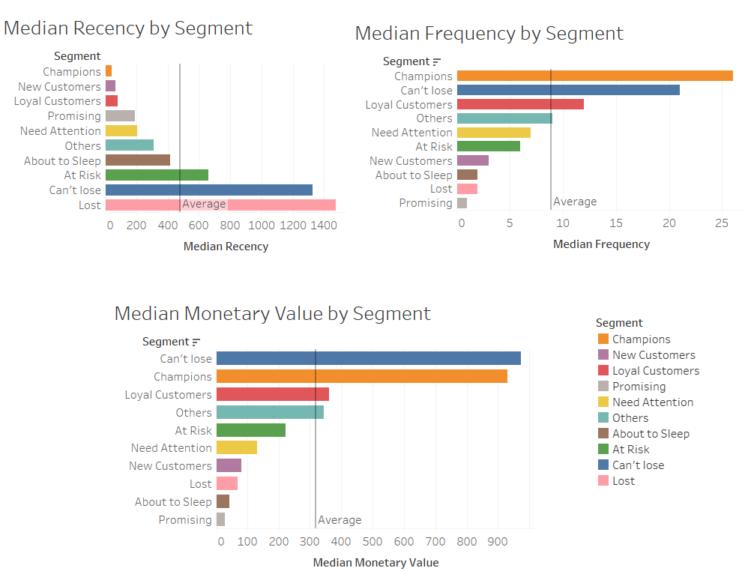
Notes:
Yue will add dashboard and worksheet to here - Yue

Slide 13
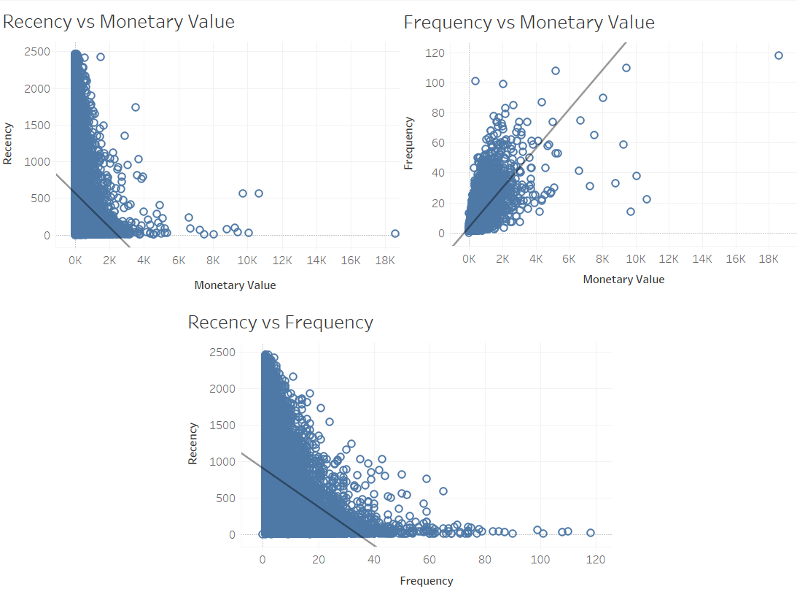
Notes:
Yue will add dashboard and worksheet to here - Yue

Slide 14
PART 03
Marketing Plan

Slide 15
Marketing Plan
Classify Segments
01
02
Stimulate Consumption

Slide 16
Book Recommendation
To improve the current engine by recommending book types based on consumers’ behaviors
Notes:
A,B,D,I column (All 11 groups)

Slide 17
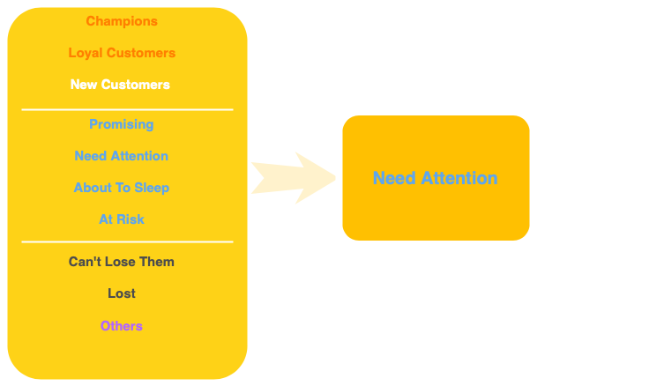
Merged Segments
42.05%
Notes:
Copied page 11

Slide 18



Customer Relationship
1
2
3
Customer Satisfaction
Email Subscription
Membership
Customer Survey
Weekly Email Newsletter
Exclusive Membership
Understand Customer’s feedback and needs
To improve products and services
Special Events Announcements
Holiday Promotion
Offer exclusive discount
Early Access to VIP events

Slide 19
Membership Program
 | SILVER | GOLD | PLATINUM | DIAMOND
Starting Points | 0 | 100 | 300 | 500
Exclusive Discount | ✖ | 3% | 5% | 10%
Free Shipping | ✖ | > $75 | > $75 | > $75
Experiences
First Access to Events | ✖ | ✖ | ✓ | ✓
Exclusive Events* | $100/ticket | $75/ticket | $50/ticket | ✓
Local Book Club | ✓ | ✓ | ✓ | ✓
Referral
Refer-A-Friend | $5/person | $5/person | $5/person | $5/person
Notes:
Fancy, wording, note

Slide 20
Economic Impact
Monetary Value = 0.019704 *Recency + 39.123813 *Frequency - 24.897294
For Top 15% Segment,
R ↓ 30%, F ↑ 25%, Monetary Value will increase by 25.68%
For Need Attention Segment,
R ↓ 20%, F ↑ 18%, Monetary Value will increase by 18.88%
Overall, we can increase the remaining 85% group’s sales by 12%
Notes:
Impact, function 公式

Slide 21
PART 04
Next Step

Slide 22
Questions
Are we able to get cost-related data for the existing customers?
Besides paperback books, do we offer E-books?

Slide 23
Thank you
Xianqian (Sarah) Yang
Kejia Ran
Minchuan (Miko) Liu
Biao Zhang
Yuanyang(Jerry) Chang
Yue Sun

Slide 24
Appendix I - Membership Program
 | SILVER | GOLD | PLATINUM | DIAMOND
Starting Points | 0 | 100 | 300 | 500
Saving
All Category Discount | ✖ | ✖ | ✖ | 10%
Specified Category Discount | ✖ | 3% | 5% | ✖
Used Book Resale | ✖ | 3% | 5% | 3%
Free Shipping | ✖ | > $75 | > $75 | > $75
Experience
Best Reader name/picture display on website | ✖ | ✖ | ✖ | ✓
Early Access - Shop at special sale prices —before everyone else! | ✖ | ✖ | ✓ | ✓
Author Discussion/ Signature admission (2 times free ticket) | $100 | $75 | $50 | ✓
Local reading group | ✓ | ✓ | ✓ | ✓
Vote for the Annual Reader Choice Awards | ✓ | ✓ | ✓ | ✓
Special Birthday Offer (Birthday Email with coupon) | ✓ | ✓ | ✓ | ✓
Referral
Refer-A-Friend(With > $25 purchase) (Max referral limit: 10 / year) | $5 each | $5 each | $5 each | $5 each
Expiration Policy | Never expired
Membership Expiration | Expire after half year for no corresponding amount of transaction
Notes:
Impact, function 公式

Slide 25
Appendix II - Segmentation Ranking
Segment | Description | Segment% | r | f | m
Champions | Bought recently, buy often and spend the most | 3.28% | 5-6 | 5-6 | 5-6
Loyal Customers | Spend good money. Responsive to promotions | 11.30% | 4-6 | 4-6 | 4-6
New Customers | Bought more recently, but not often | 20.94% | 4-6 | 1-4 | 1-4
Promising | Recent shoppers, but haven’t spent much | 5.51% | 4-5 | 1-4 | 1-2
Need Attention | Above average recency, frequency & monetary values | 2.31% | 3-5 | 3-5 | 2-3
About to Sleep | Below average recency, frequency & monetary values | 22.51% | 2-3 | 1-3 | 1-3
At Risk | Spent big money, purchased often but long time ago | 11.72% | 1-2 | 2-6 | 2-6
Can't Lose Them | Made big purchases and often, but long time ago | 0.02% | 1 | 5-6 | 5-6
Lost | Low spenders, low frequency, purchased long time ago | 15.62% | 1 | 1-4 | 1-4
Others | incorrect data OR enterprise level customer | 6.78%
Notes:
Impact, function 公式

Slide 26
Appendix III - Revenue Projection
Segment | Segment% | R ↓ by | F ↑ by | Revenue Increase %
Top 15% | 14.58% | 30% | 25% | 78.57%
New Customers | 20.94% | 25% | 18% | 57.33%
Need Attention | 42.05% | 20% | 15% | 43.75%
Can't Lose Them | 15.64% | 5% | 5% | 10.53%
Others | 6.78% | 3% | 3% | 6.19%
Notes:
Impact, function 公式

Slide 27
Appendix IV - Reference
PowerPoint Template:
https://docs.google.com/presentation/d/17eL3rL4SZxrDjqWSzM07-_Orcuaf66hPWyizzLAbugQ/edit?usp=sharing
RFM Method:
https://www.r-bloggers.com/2019/07/customer-segmentation-using-rfm-analysis/
Notes:
Impact, function 公式

